Slide 1
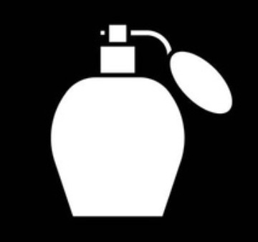
Fragrance Market Exploration
Charlotte ZHU

Slide 2

Agenda
Industry Overview
Insight into Perfume Accords

Slide 3
1
Industry Overview
How do fragrance brands differ in
e-commerce strategy?

Slide 4

Background Introduction
773 million
33%
Fragrance e-commerce users
Revenue share of the online fragrance market by 2025
(Source: Statista)
Data Source: eBay
Detailed information of 2,000 perfume listings to partly showcase the pricing, sales, and other aspects of the current e-commerce market of perfumes

Slide 5
Result: Positioning Matrix
HIGH PRICE
Insight 1:
Balanced supply of female & male fragrances
$70
Yves Saint Laurent
Paco Rabanne
High Price
Low Volume
High Price
High Volume
Azzaro
Burberry
Ralph Lauren
Armaf
LOW VOLUME
HIGH VOLUME
10
Versace
50
Dolce & Gabbana
Davidoff
Low Price
Low Volume
Low Price
High Volume
Calvin Klein
Insight 2:
4 Strategic quadrants
$20
LOW PRICE
Data Source: eBay

Slide 6
2
Insight into Perfume Accords
what combinations of accords do brands present?

Slide 7
Background Introduction
Accord
Perfume
a specific combination of ingredients that create a distinct smell
the final product that often blends multiple accords
Data Source: Parfumo (an online community for perfume)

Slide 8

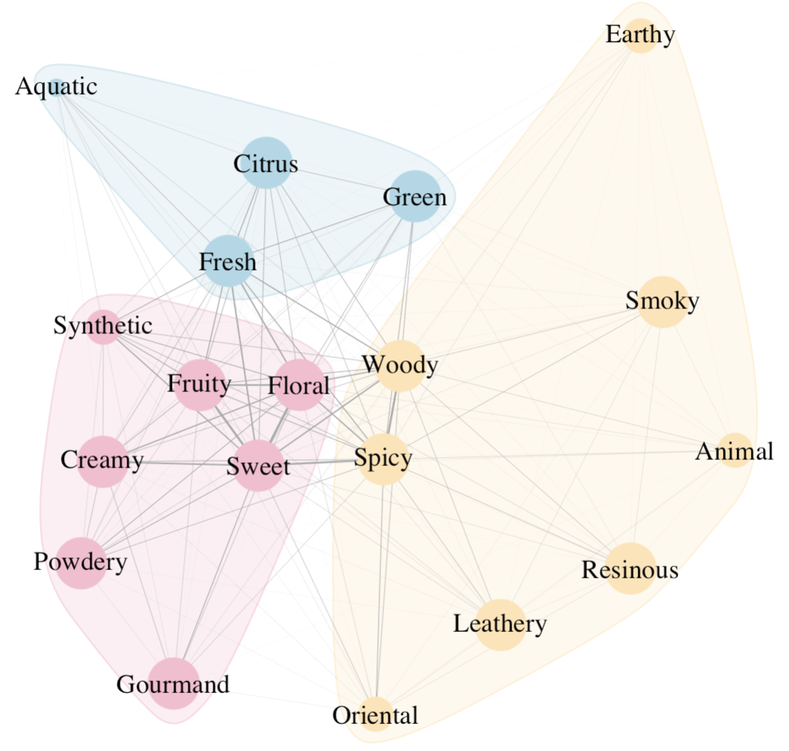
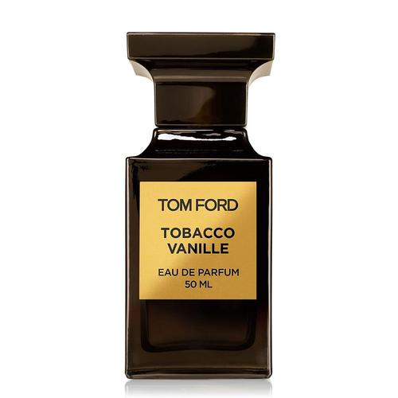
Result: Accord Network Diagram
Insight 1
Insight 2
3 accord communities bring consumers different sensory experiences
Dense areas are well-established formula combinations, safe for creating multi-sensory experience
Warm &
Mysterious
Insight 3
Sweet & Feminine
Sparse areas may be a blue ocean of opportunities
Fresh &
Vital
Tom Ford
Tobacco Vanille
Data Source: Parfumo

Slide 9
Summary
Industry Overview
Balanced gender positioning
Four distinct strategic quadrants (price & volume)
Insight into Perfume Accords
3 accord communities bring consumers different sensory experiences
Safe formula (dense area) versus innovation (sparse area)

Slide 10
Thanks!

